Slide 1
8:- Dataset iris contains 50 samples from each of 3 species of Iris (Iris setosa, Iris virginica and Iris versicolor). Split the data into training and test data. Build naive bytes for this data.

Slide 2
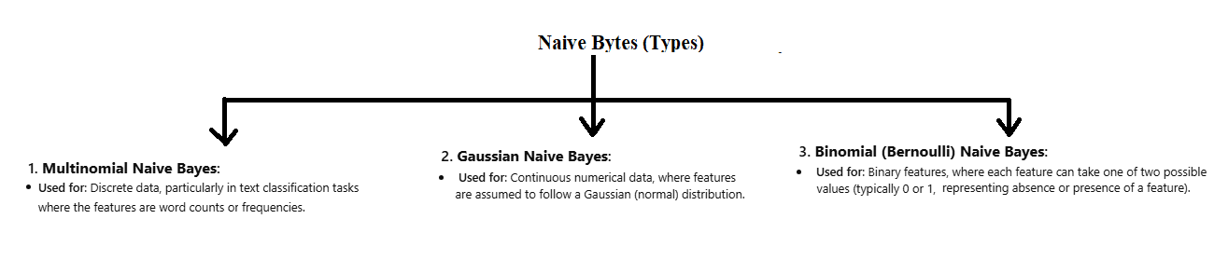
Types of Naïve Bytes

Slide 3
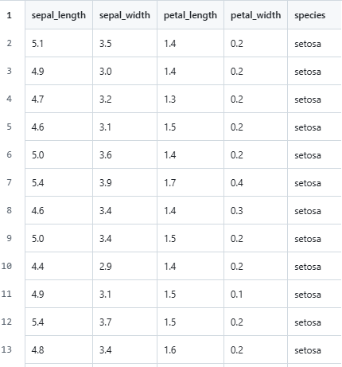
Here, we will use Gaussian Naïve bytes because the features are in numbers.

Slide 4

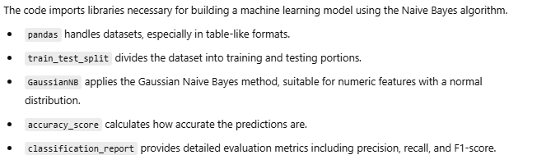

Slide 5
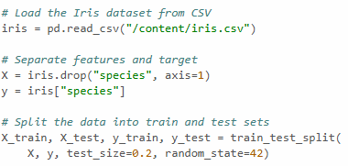
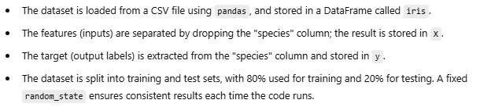

Slide 6
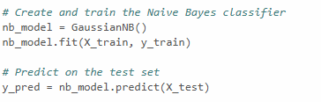
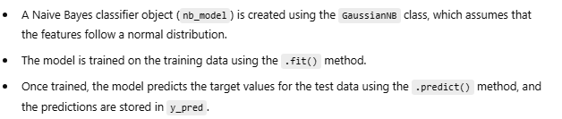

Slide 7
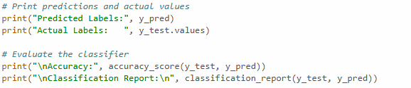
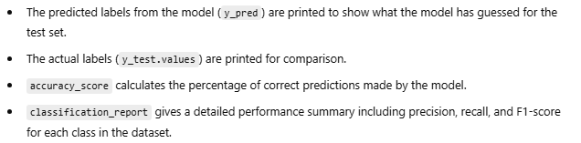

Slide 8
